Slide 1


12:34

Slide 2
12:34
Trips
In the home screen, you can view your past, current, and upcoming itineraries.
PAST
ACTIVE
UPCOMING
Shanghai
21 AUG -25 AUG
NEW TRIP
Click on “+ NEW TRIP” to start planning your itinerary.

Slide 3
12:34

Slide 4

12:34
BACK
Enter your destination
Enter your travel information, or upload a photo of your flight receipt.
Singapore
Singapore, Singapore
UPLOAD FLIGHT DETAILS

Slide 5
12:34
BACK
Enter your travel information, or upload a photo of your flight receipt.
UPLOAD FLIGHT DETAILS

Slide 6
12:34
BACK
Which dates will you be travelling?
Enter your travel information, or upload a photo of your flight receipt.
FROM
TO
01/10/2019
04/10/2019
ENTER
UPLOAD FLIGHT DETAILS

Slide 7
12:34
BACK

Slide 8
12:34
BACK
Enter your
intended residence
Set your intended overseas residence, or continue without one.
Marriot Hotel
ENTER
Marriot Hotel, Orchard Road
I HAVEN’T DECIDED YET

Slide 9
12:34
BACK

Slide 10
12:34
BACK
Where do you want to visit?
List down the places of interest that you would like to visit during your trip.
Marina Barrage
Marina Barrage, Singapore
NEXT

Slide 11
12:34
BACK
Where do you want to visit?
List down the places of interest that you would like to visit during your trip.
Marina Barrage
NEW LOCATION
NEXT

Slide 12
12:34
BACK
Where do you want to visit?
List down the places of interest that you would like to visit during your trip.
Marina Barrage
Sentosa
Palawan Beach, Sentosa
Siloso Beach, Sentosa
NEXT

Slide 13
12:34
BACK
Where do you want to visit?
List down the places of interest that you would like to visit during your trip.
Marina Barrage
Siloso Beach, Sentosa
NEW LOCATION
NEXT

Slide 14
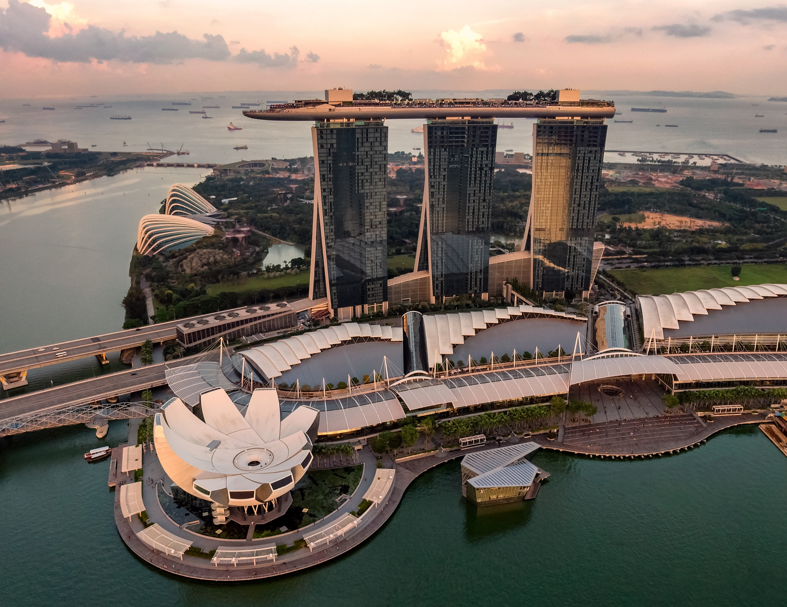
12:34

Slide 15
12:34
Creating itinerary….

Slide 16
12:34

Slide 17
12:34
SINGAPORE
1-7 OCTOBER – ITINERARY
1 OCT
2 OCT
3 OCT
You can edit and change your preferences.
REORDER SEQUENCE
EDIT PREFERENCES
0900
COMMUTE
LEAVE MARRIOT HOTEL SINGAPORE
30mins
NAVIGATION
0930 - 1100
TRAFFIC - LOW
ARRIVE AT MARINA BARRAGE
1hr
NAVIGATION
TRAFFIC – HIGH
ARRIVE AT SENTOSA
TRVL will alert you of overcrowded locations and recommend you alternatives.
1100 – 1200
15min
NAVIGATION
VIEW ALTERNATIVES
TRVL will recommend you nearby locations along your route based on your interests and preferences.
RECOMMENDED
LUNCH AT JUMBO SEAFOOD
1300 – 1400
1hr 10min
NAVIGATION
VIEW ALTERNATIVES
1730
COMMUTE
ARRIVE AT MARRIOT HOTEL – SINGAPORE
MAP VIEW
RANK BY
FILTER BY
HAW PAR VILLA
CULTURE, ATTRACTIONS
4.1
(1,061 REVIEWS)
READ MORE
VIVOCITY
SHOPPING
3.6
(2,144 REVIEWS)
READ MORE
LABRADOR PARK
NATURE, PARKS
4.3
(254 REVIEWS)
READ MORE

Slide 18
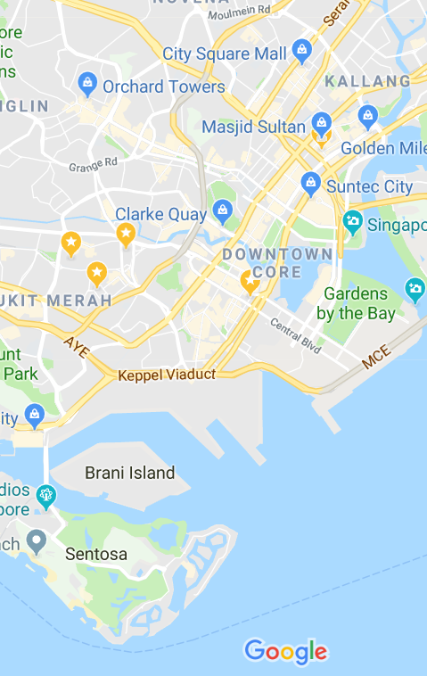



12:34
SINGAPORE
1-7 OCTOBER – ITINERARY
1 OCT
2 OCT
3 OCT
Navigate easily with TRVL’s maps powered by Google.
TIMELINE VIEW

